Slide 1

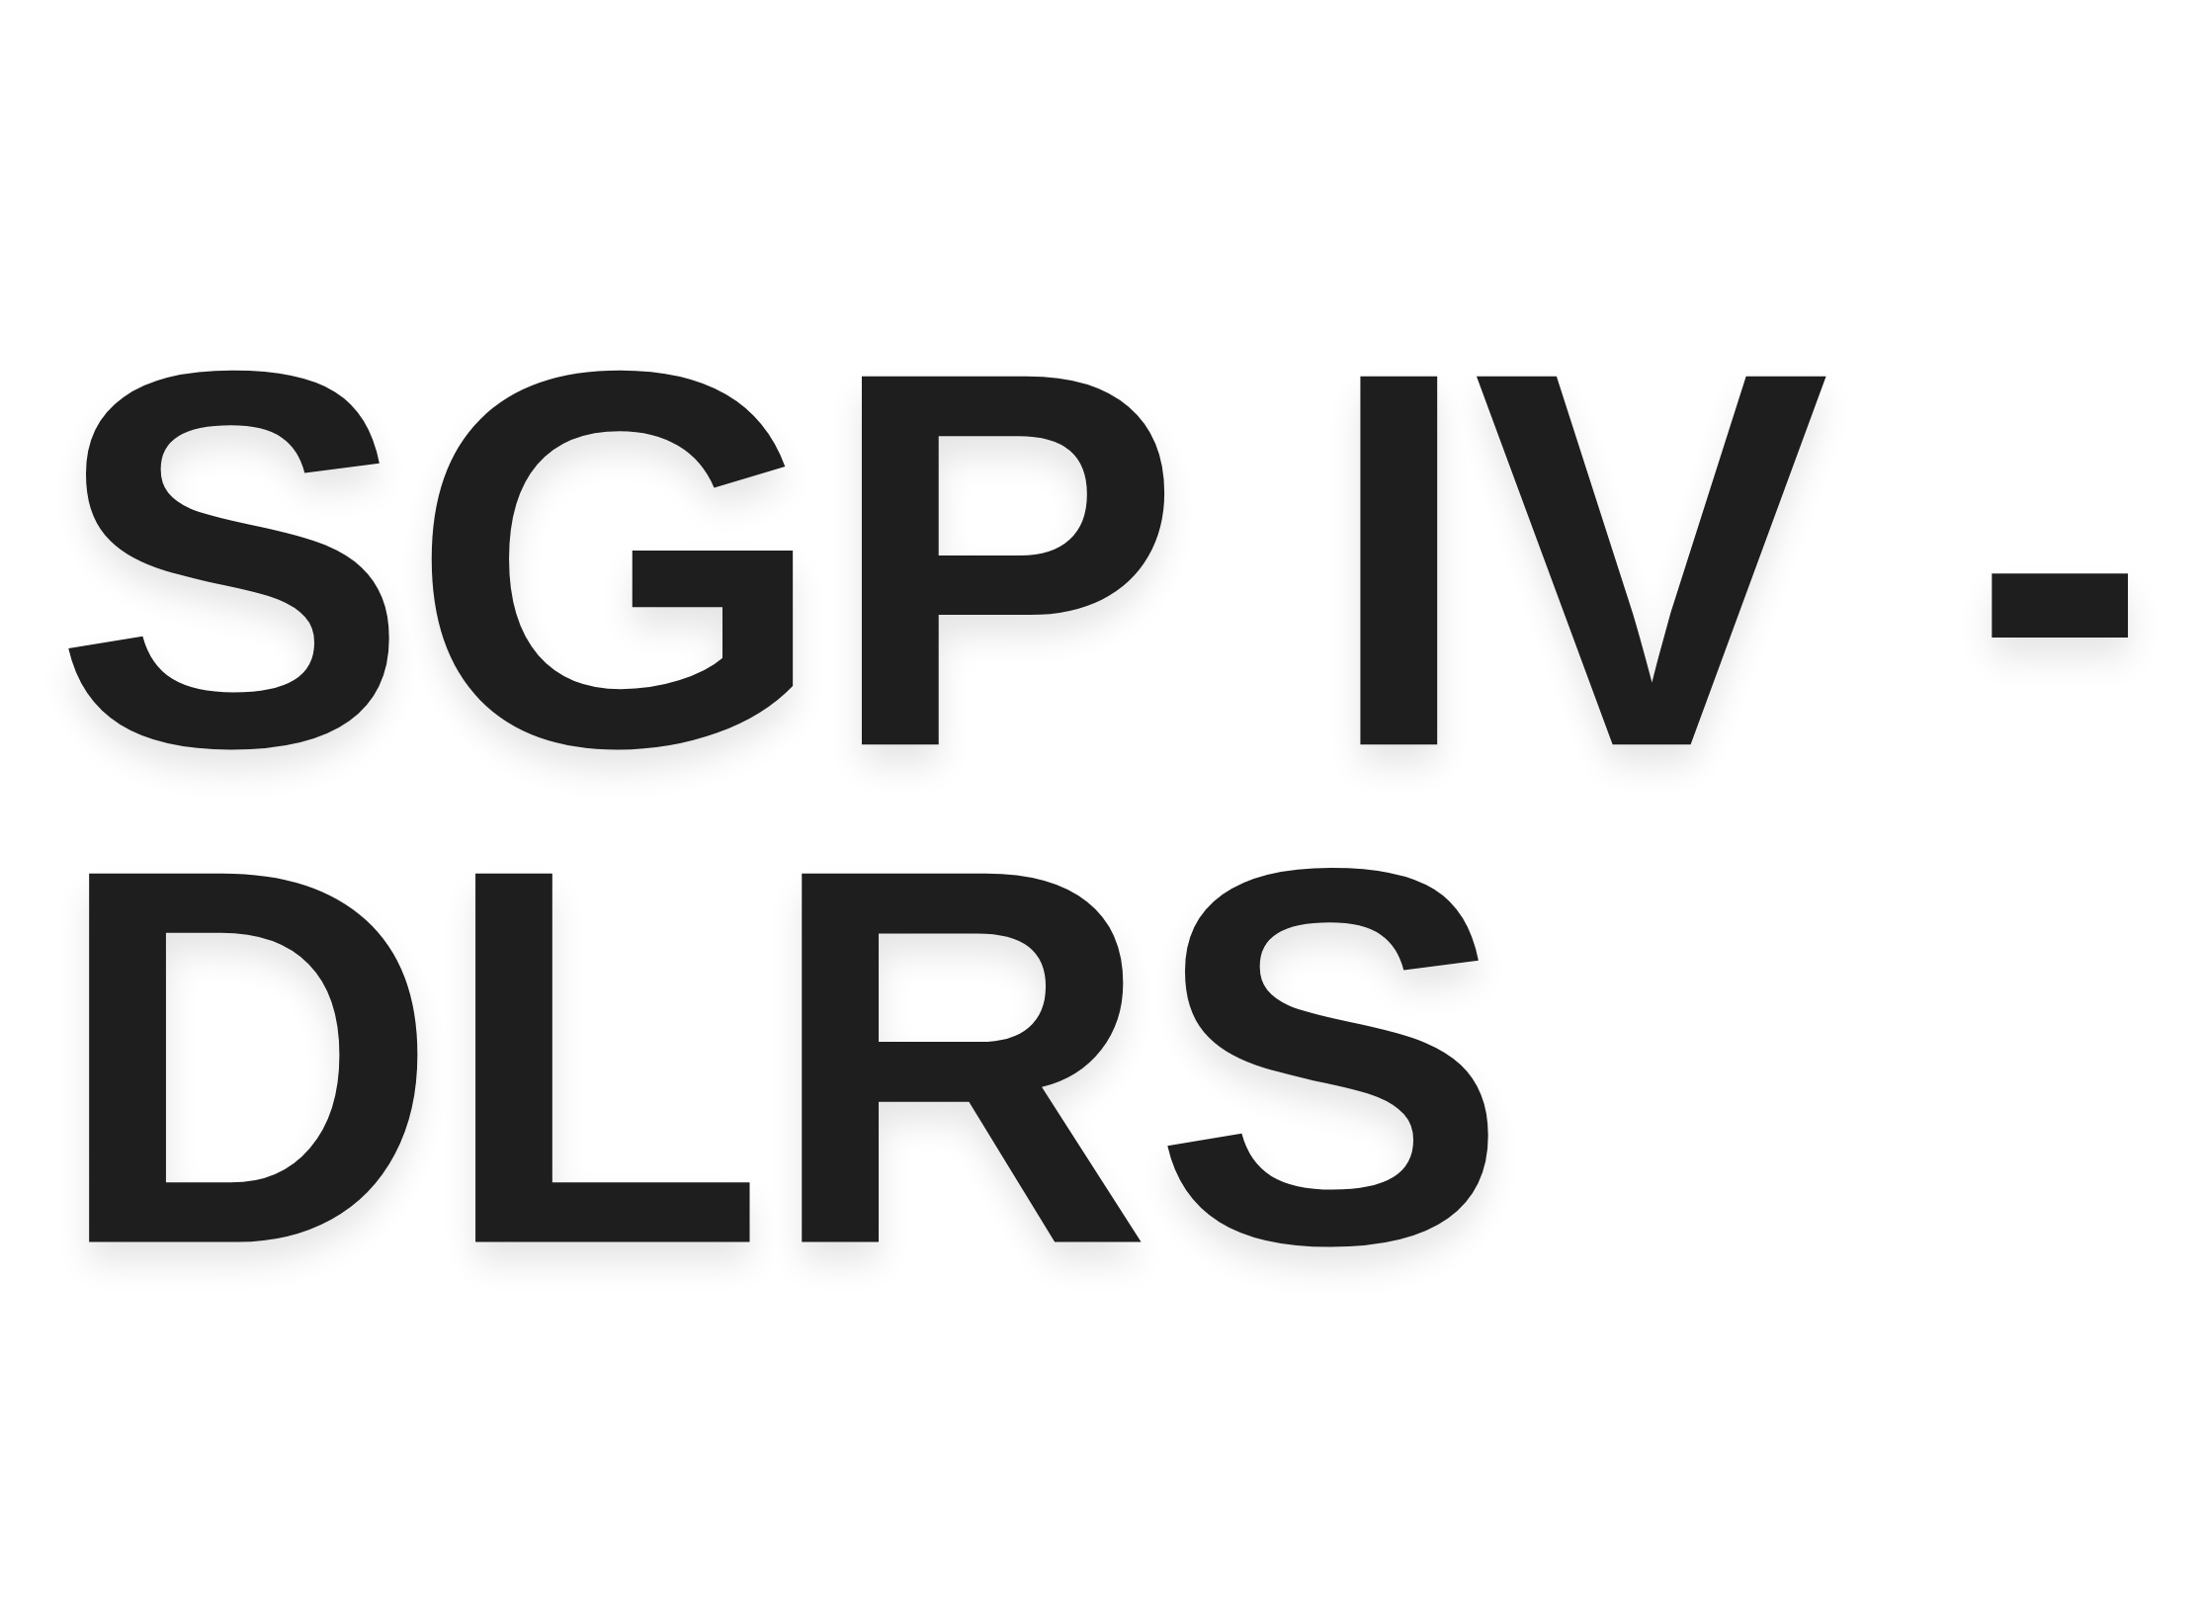
Advanced Recommender Systems

Slide 2
Agenda
The points to be covered during this presentation
Topics Covered
What is recommender system? Applications of recommender system Types of recommender system
Text Based Recommender System Cross-domain Recommender System Multi-criteria Recommender System

Slide 3


Literature Review
Aim Selection
Coding Phase
Research Paper
Referring to research papers and understanding the current technologies
Deciding the aim from the limitations of the current projects
Creating a recommender system according to the aim
Writing and publishing research paper for the project
Flow of a research project

Slide 4

What is a Recommender
System?
A Recommender System is a composition of software tools and machine learning techniques.
It provides a valuable piece of advice for items or services chosen by a user.
Currently useful in both the research and commercial areas

Slide 5
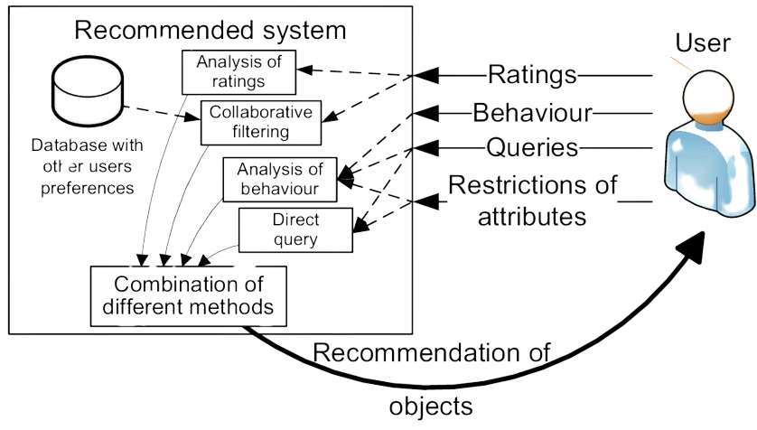
Diagram

Slide 6
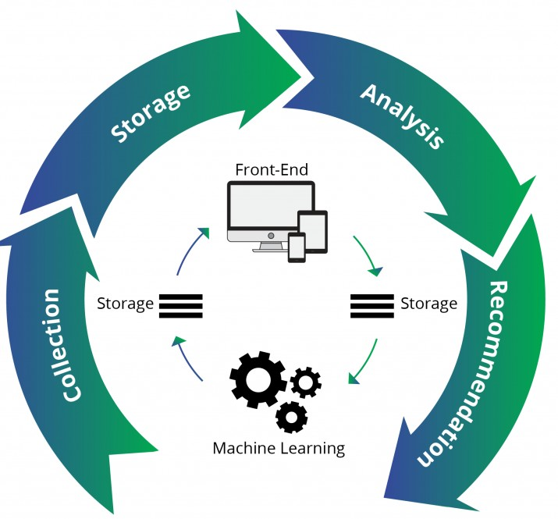
Process
Sequence
How does a recommender system work

Slide 7
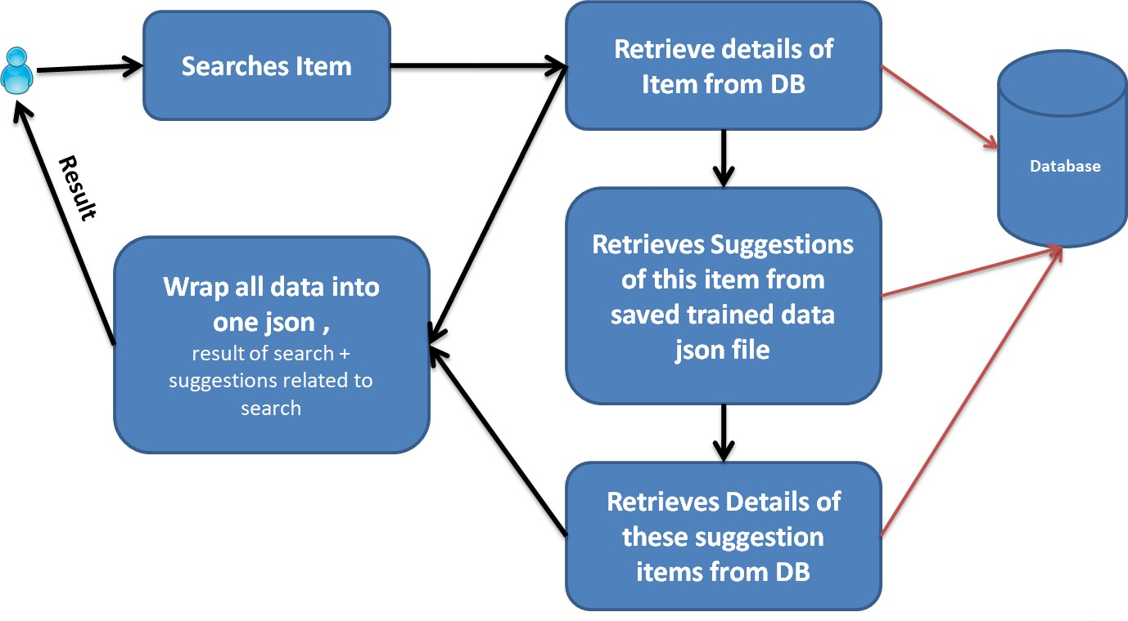
Flow Chart

Slide 8

Applications of
Recommender
System
Real life uses of recommender system

Slide 9
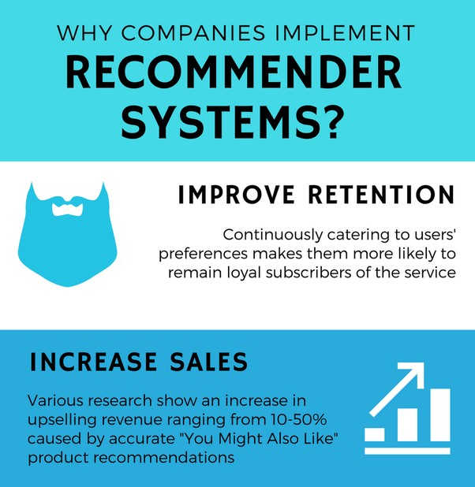
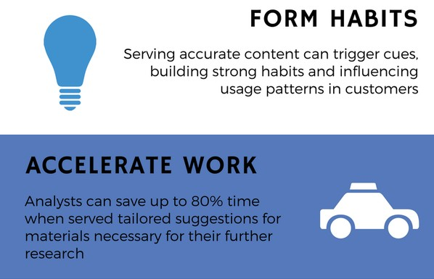

Slide 10




Use of Recommender Systems
Platforms that use use it rigorously
Facebook
Amazon
Instagram
Netflix
Flipkart

Slide 11
Types of
Recommender
System
Categories of recommender system

Slide 12
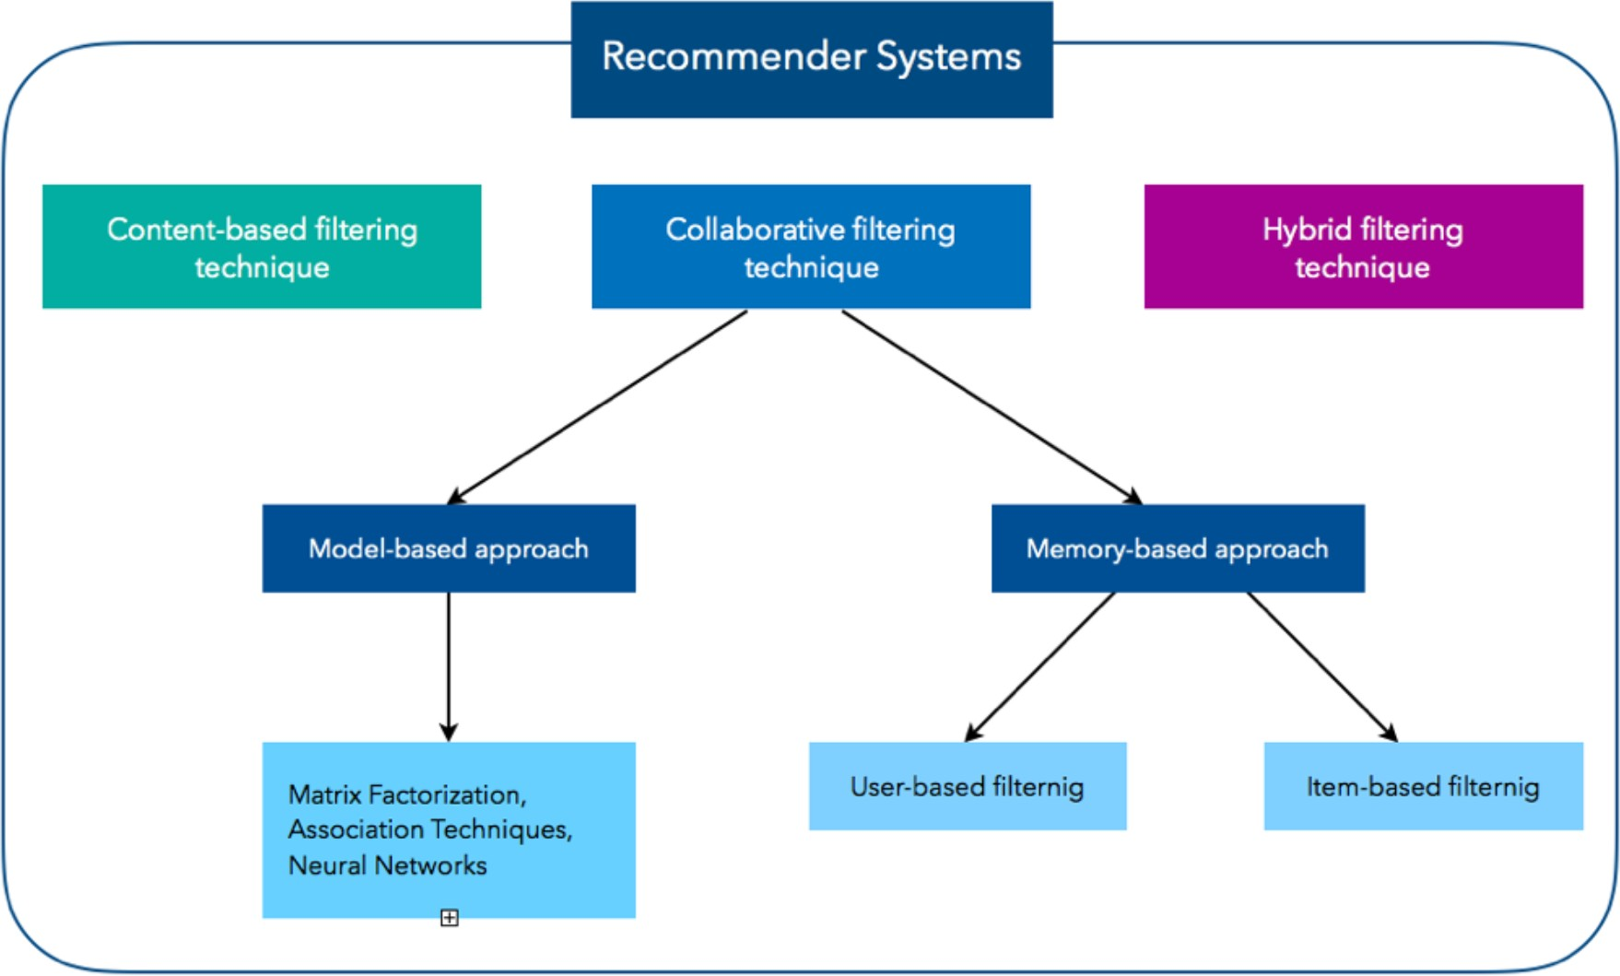

Slide 13
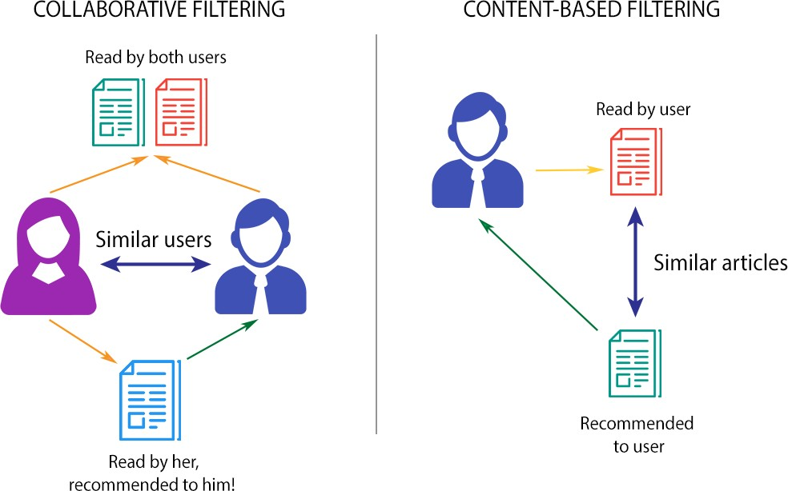

Slide 14
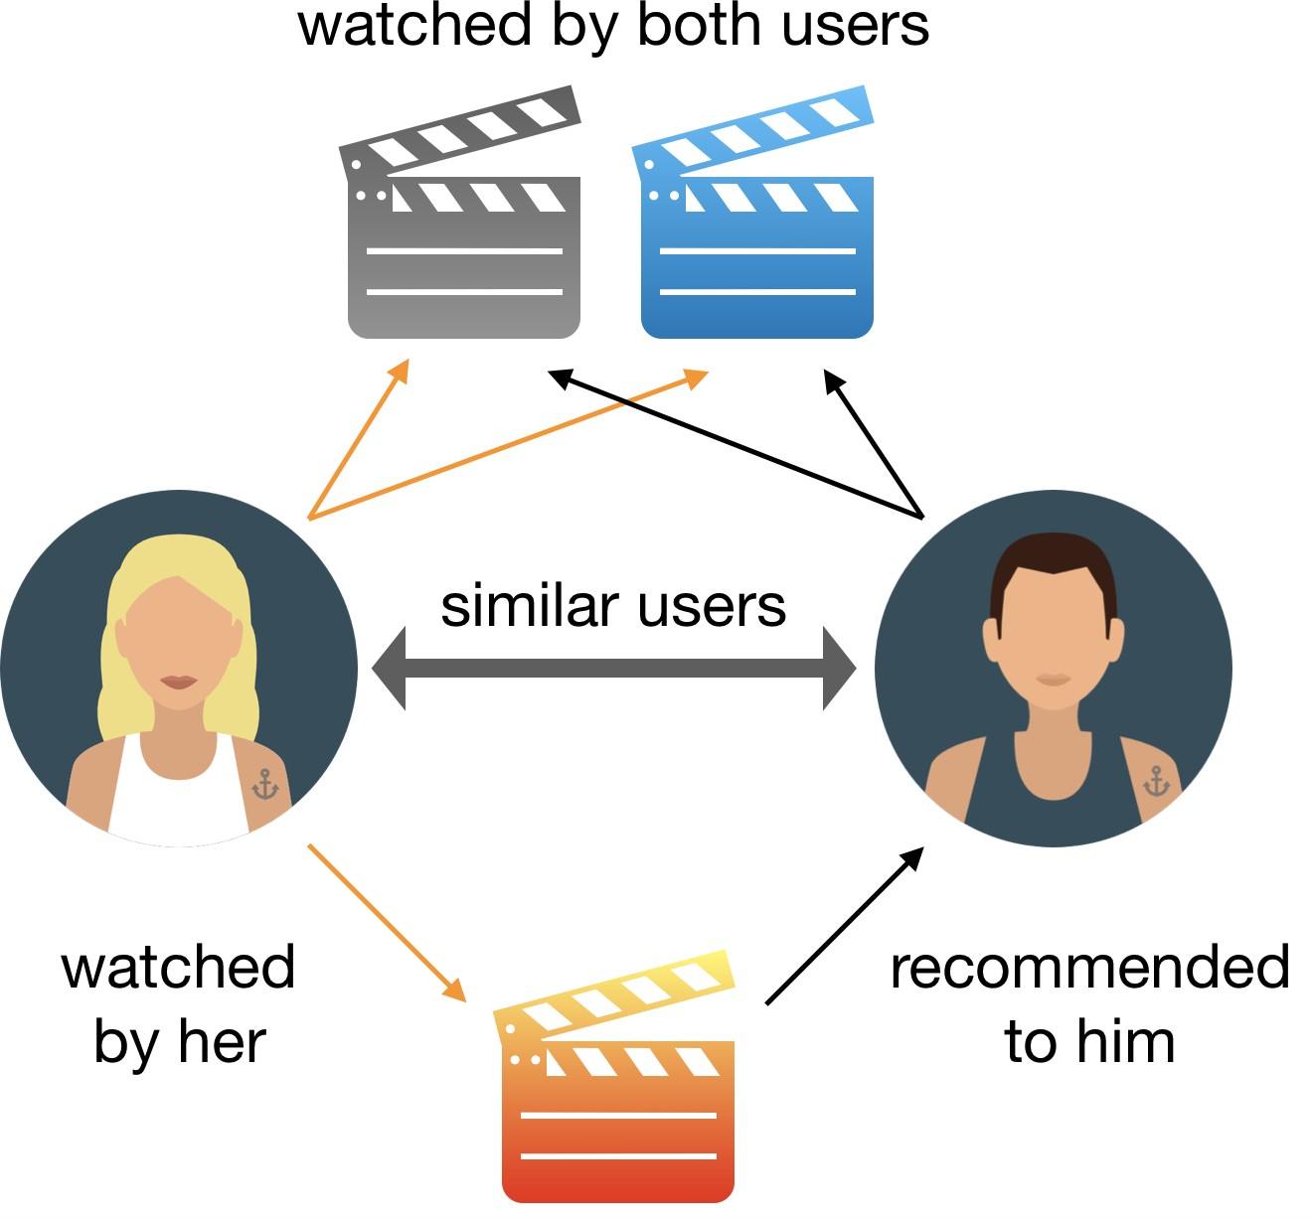
Collaborative
Filtering
Example

Slide 15
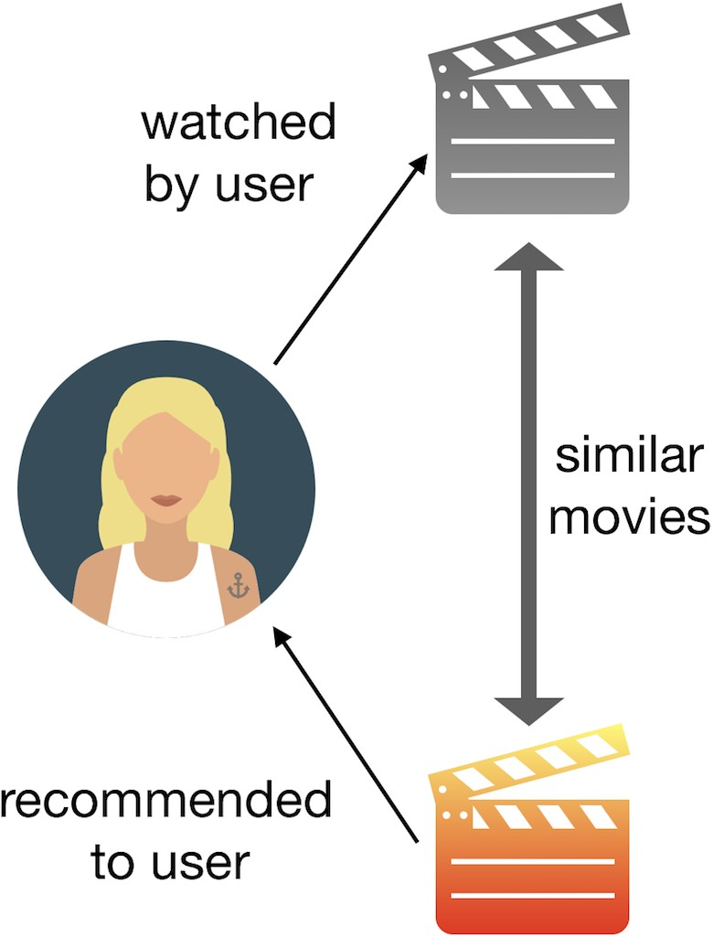

Example

Slide 16
Text-Based
Recommender System
19CE135 Jainil Shah

Slide 17
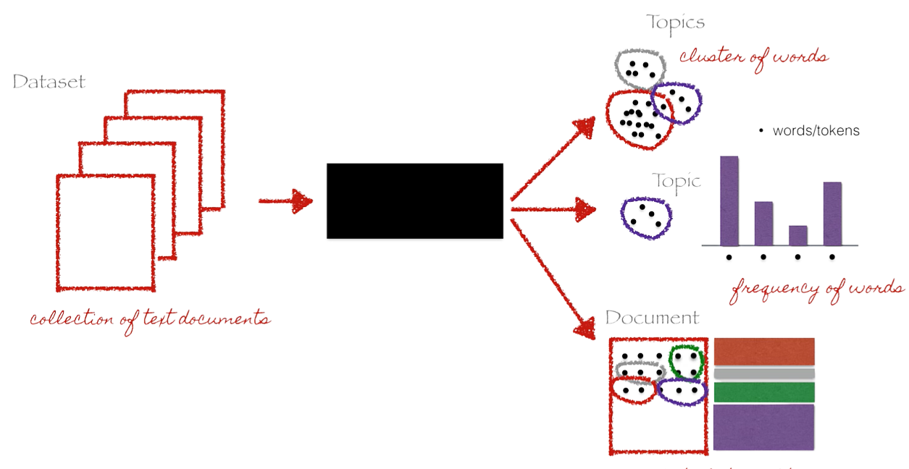
Overview

Slide 18
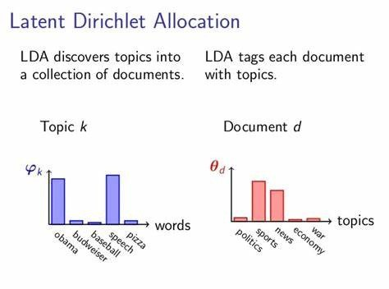

Slide 19
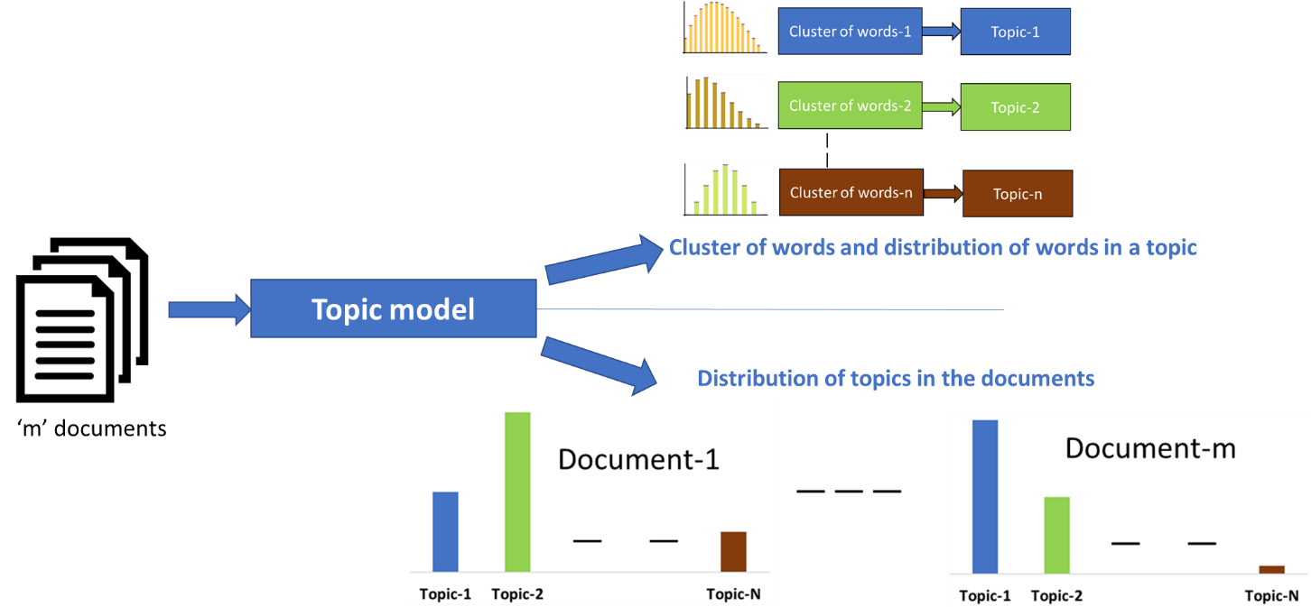
Diagram

Slide 20
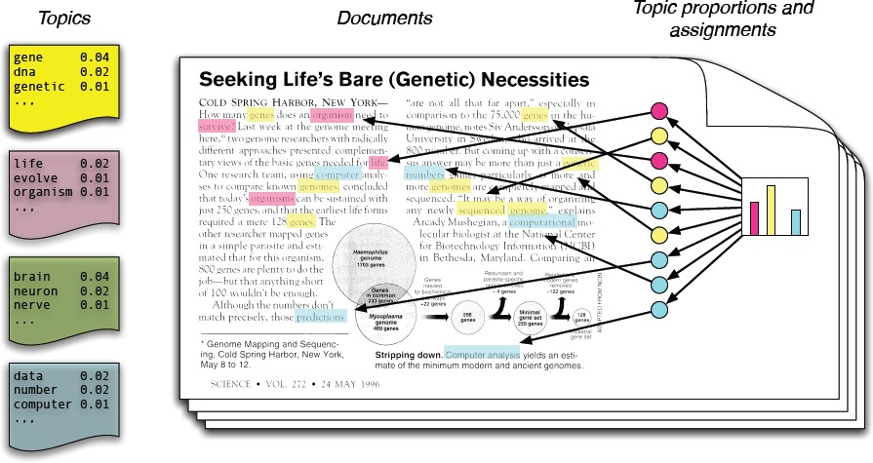
LDA uses NLP(Natural Language Processing)

Slide 21
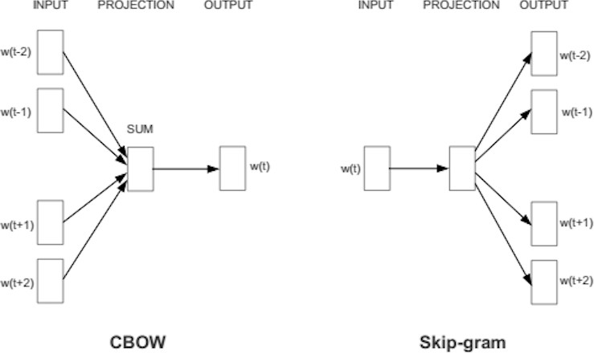
Word 2 Vec(W2V) Types:

Slide 22
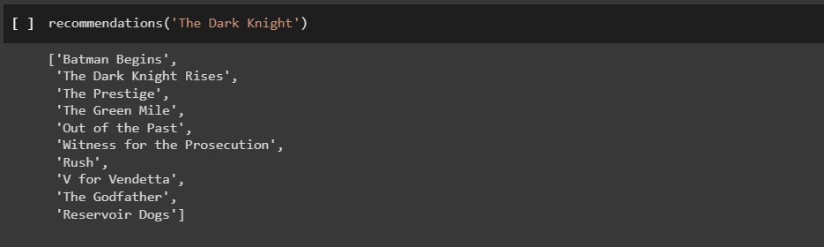
Practical Task - 1
MOVIE RECOMMENDER SYSTEM USING COSINE SIMILARITY

Slide 23
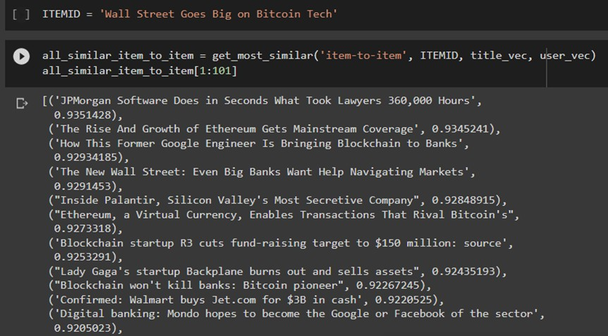
Practical Task - 2A
ARTICLE RECOMMENDATION USING WORD 2 VEC

Slide 24
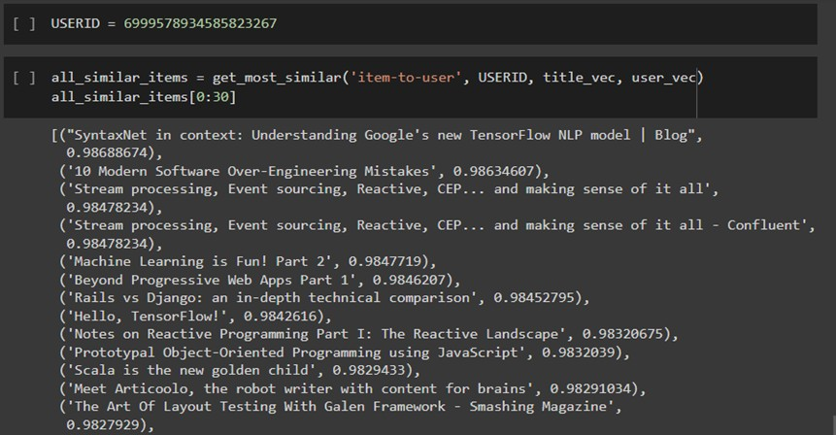
Practical Task - 2B
ARTICLE RECOMMENDATION USING WORD 2 VEC

Slide 25
Cross-Domain
Recommender System
cross-domain with collaborative-filtering
19CE018 Vansh Desai

Slide 26
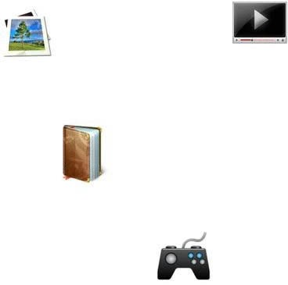
Data Sparsity
ANIMATION

Slide 27
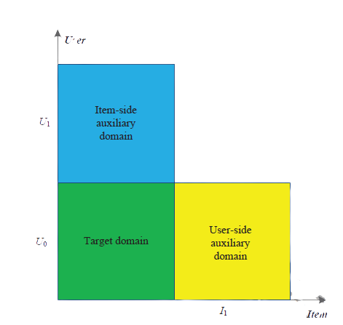
Latent factor
Cross Domain
This System basically defined for data sparsity

Slide 28

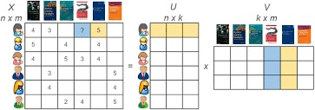
SVD is used to find Latent Factor

Slide 29
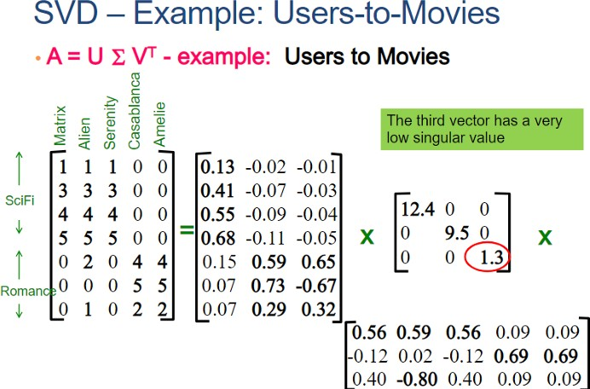

Slide 30
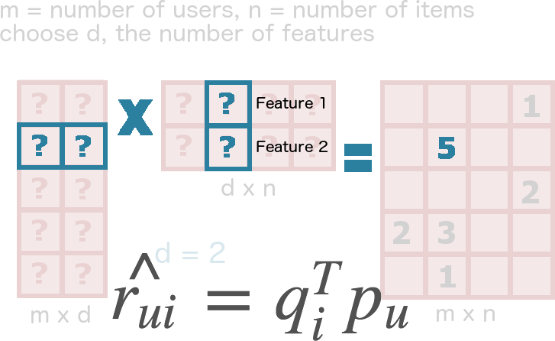
Use of Latent Factor

Slide 31
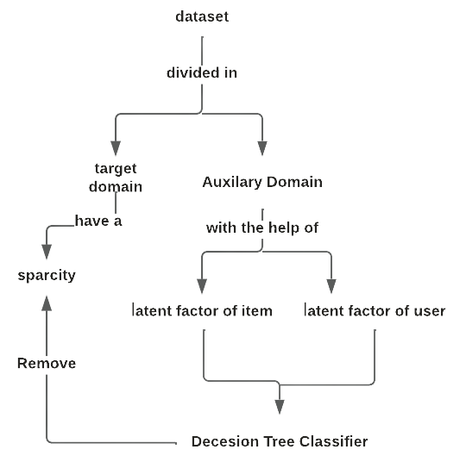


Slide 32
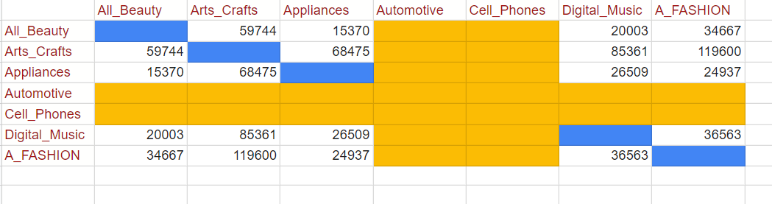
Practical Task -1
CROSS-MATRIX

Slide 33
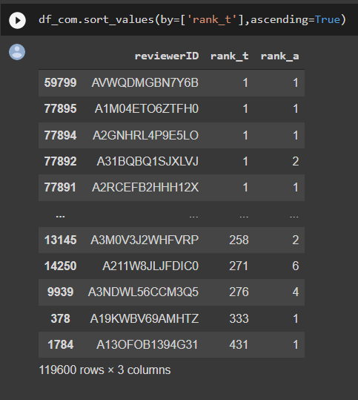
Practical Task - 1
RESPONSE OF USERS IN EVERY DOMAIN

Slide 34
Multi-Criteria
Recommender System
19CE129 Aman Shah

Slide 35
What is a Multi-Criteria
Recommender System?
Multi-criteria recommender systems (MCRSs) refer to systems that leverage multiple user ratings of various item criteria in addition to overall user-item ratings to support recommendations.

Slide 36
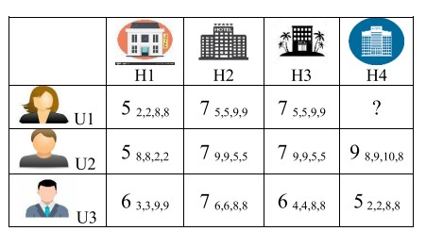
Multi-criteria Matrix

Slide 37
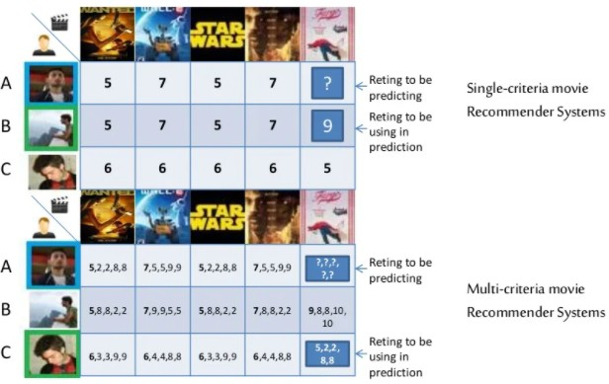

Slide 38
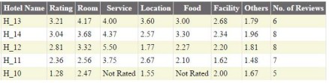
Multi-criteria Dataset

Slide 39
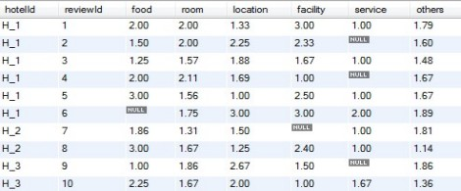
Multi-criteria Dataset

Slide 40
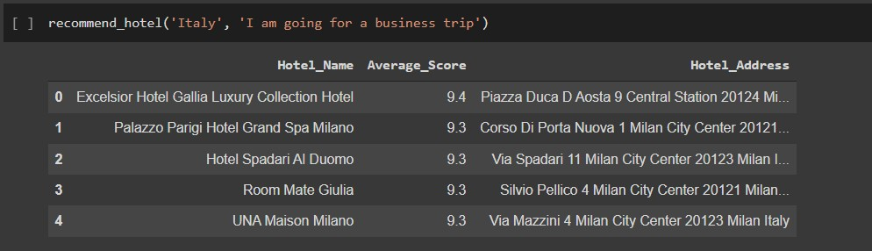
Practical Task
HOTEL RECOMMENDER SYSTEM

Slide 41

M. Wijewickrema, V. Petras, and N. Dias, “Selecting a text similarity measure for a content-based recommender system: A comparison in two corpora,” EL, vol. ahead-of-print, no. ahead-of-print, Jul. 2019, doi: 10.1108/EL-08-2018-0165.
S. Loh, F. Lorenzi, R. Saldaña, and D. Licthnow, “A TOURISM RECOMMENDER SYSTEM BASED ON COLLABORATION AND TEXT ANALYSIS,” Information Technology & Tourism, vol. 6, no. 3, pp. 157– 165, Jan. 2003, doi: 10.3727/1098305031436980.
R. Katarya and Y. Arora, “Capsmf: a novel product recommender system using deep learning based text analysis model,” Multimed Tools Appl, vol. 79, no. 47–48, pp. 35927–35948, Dec. 2020, doi: 10.1007/s11042-020-09199-5.
Y. Soo Kim, “Text recommender system using user’s usage patterns,” Industrial Management & Data Systems, vol. 111, no. 2, pp. 282–297, Mar. 2011, doi: 10.1108/02635571111115182.

Slide 42


S. Berkovsky, T. Kuflik, and F. Ricci, “Cross-Domain Mediation in Collaborative Filtering,” in User Modeling 2007, vol. 4511, C. Conati, K. McCoy, and G. Paliouras, Eds. Berlin, Heidelberg: Springer Berlin Heidelberg, 2007, pp. 355–359. doi: 10.1007/978-3-540-73078-1_44.
I. Cantador, I. Fernández-Tobías, S. Berkovsky, and P. Cremonesi, “Cross-Domain Recommender Systems,” in Recommender Systems Handbook, F. Ricci, L. Rokach, and B. Shapira, Eds. Boston, MA: Springer US, 2015, pp. 919–959. doi: 10.1007/978-1-4899-7637-6_27.
I. of E. and E. E. ICTAS, I. C. T. and S. Conference on Information Communications Technology and Society, I. and S. ICTAS: Information Communication Technology and Society, and ICTAS, 2018 Conference on Information Communications Technology and Society (ICTAS) proceedings: 8-9 March 2018, Durban, South Africa. 2018. Accessed: Feb. 25, 2022.
X. Yu, F. Jiang, J. Du, and D. Gong, “A cross-domain collaborative filtering algorithm with expanding user and item features via the latent factor space of auxiliary domains,” Pattern Recognition, vol. 94, pp. 96–109, Oct. 2019, doi: 10.1016/j.patcog.2019.05.030.

Slide 43
Thank you!

